Slide 1
Decision Trees and Random Forests
Materials: ://bit.ly/2ot4qhttpsp7
Check in: http://bit.ly/2mfZkf2
302316

Slide 2
1) Decision Trees
What are they and where can they be applied?
2) Ensemble Learning
General Concepts and Random Forests
3) Case Study
Applying what we learnt to a real world dataset!

Slide 3
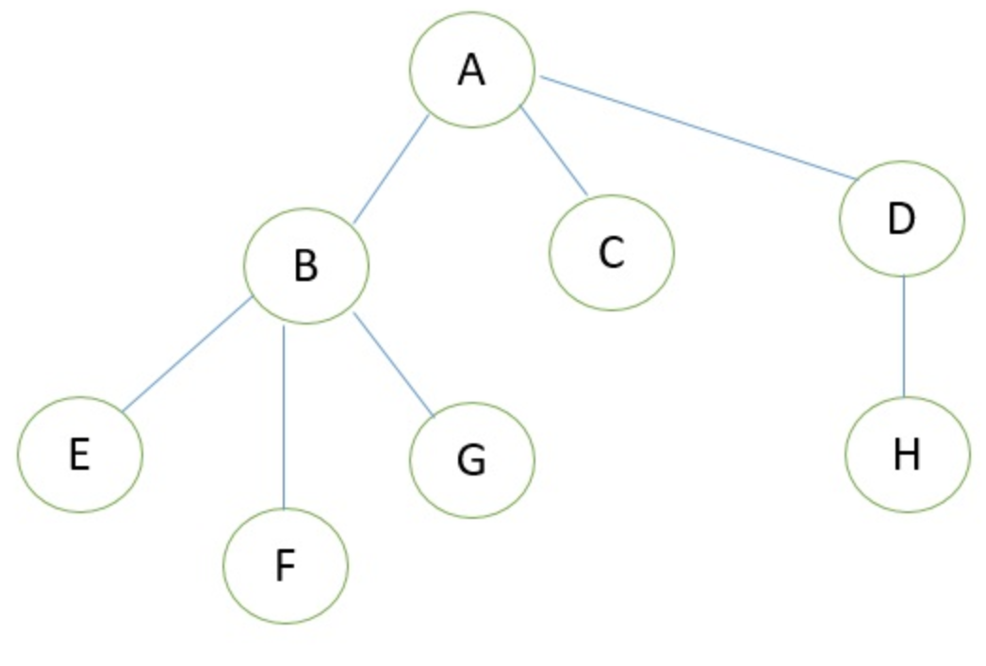
So, what are these trees you speak of?
An abstraction of data
Mostly represent hierarchical relationships.
Applications in multiple fields!

Slide 4
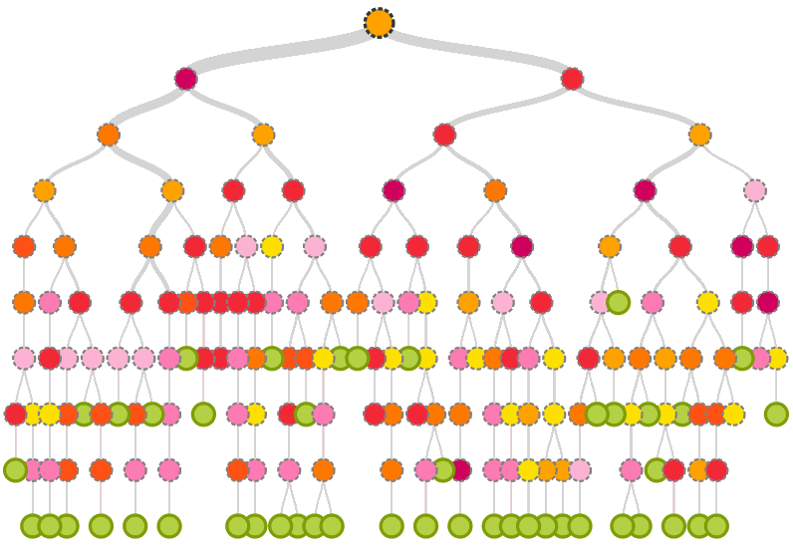
Enter Decision Trees
Simple, but extremely versatile supervised learning algorithm.
Able to perform classification and regression!
Building blocks for many powerful models.

Slide 5
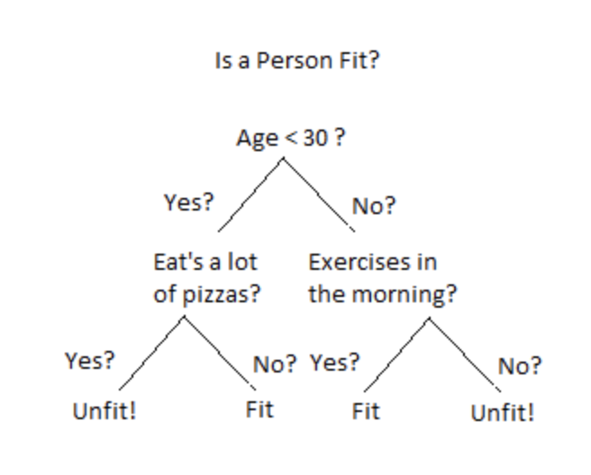
Jumping into the algorithm: Splitting
Dataset is broken down into smaller and smaller subsets via splitting!
Each split represents a binary decision being made on a specific attribute of the data.

Slide 6
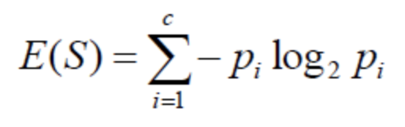
Jumping into the algorithm: What makes a good split?
Need to divide the data into subsets of similar values.
Entropy: Measure of disorder amongst a sample.
Information Gain: Decrease in entropy after dataset is split on an attribute.
Goal is to perform a split that returns the highest information gain.

Slide 7
Actually jumping into the algorithm...
Calculate entropy of target.
Calculate entropy for each branch.
Choose attribute with largest information gain.
Repeat

Slide 8
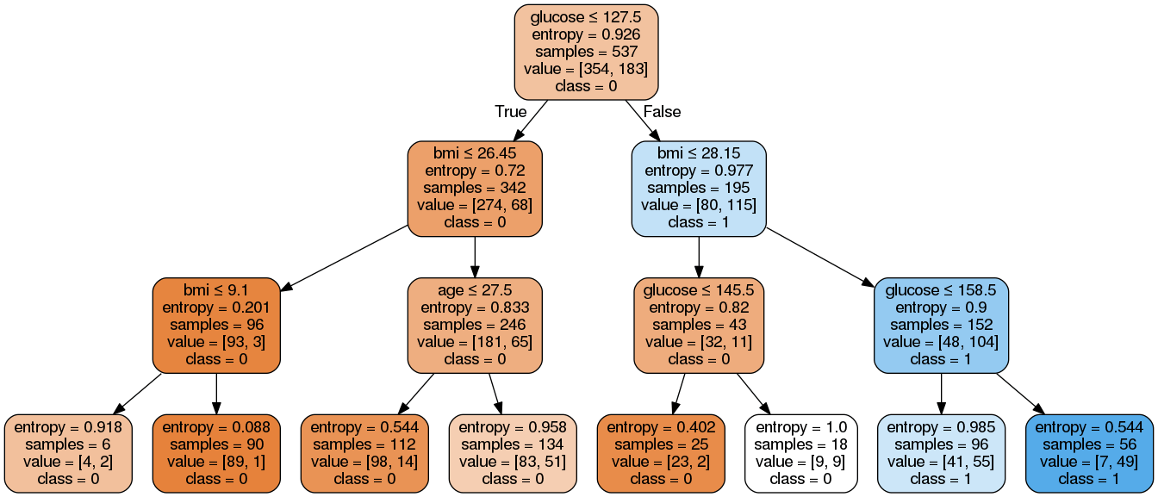
An example

Slide 9
Preventing Overfitting: Pruning
Algorithm is extremely prone to overfitting.
Reducing the size of the tree by converting decision nodes into leaf nodes.
Results in models that generalize well.
Notes:
Overfitting - when you use too much training data that the tree begins to ‘memorize’ the answers

Slide 10
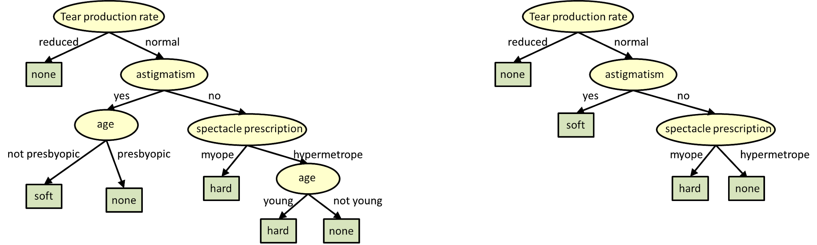
An Example of Pruning

Slide 11
Ensemble Learning: is one tree the best we can do?
Model that makes predictions based on a number of different models.
Bagging: Training a bunch of models in a parallel way. Each model uses random subset of data!
Notes:
Combining weak learners to create a strong learner

Slide 12
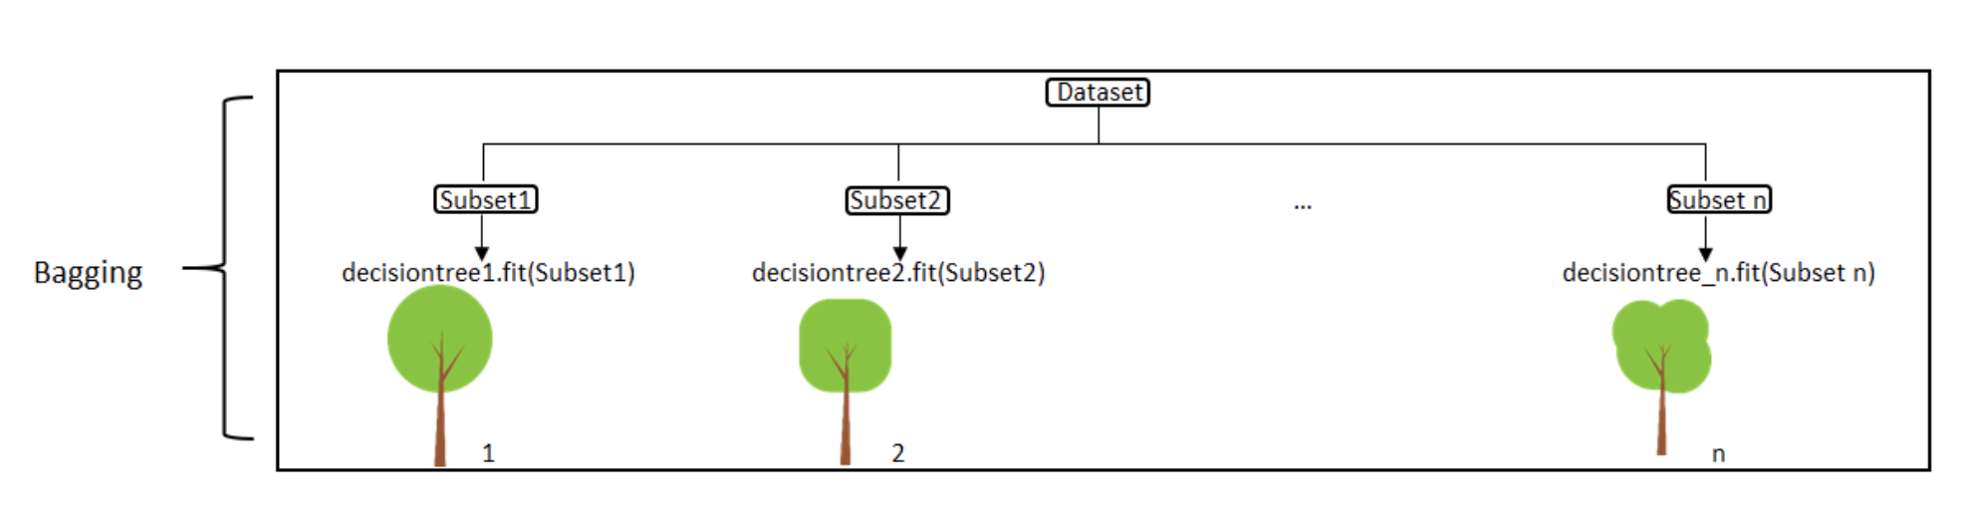
Bagging Visualized

Slide 13
Let’s grow some trees: Random Forests
Ensemble method that uses bagging as the ensemble method and decision tree as the individual model.
Select n random subsets of the data.
Train n decision trees.
Obtain prediction from each tree.
Make final prediction based on the majority vote!

Slide 14
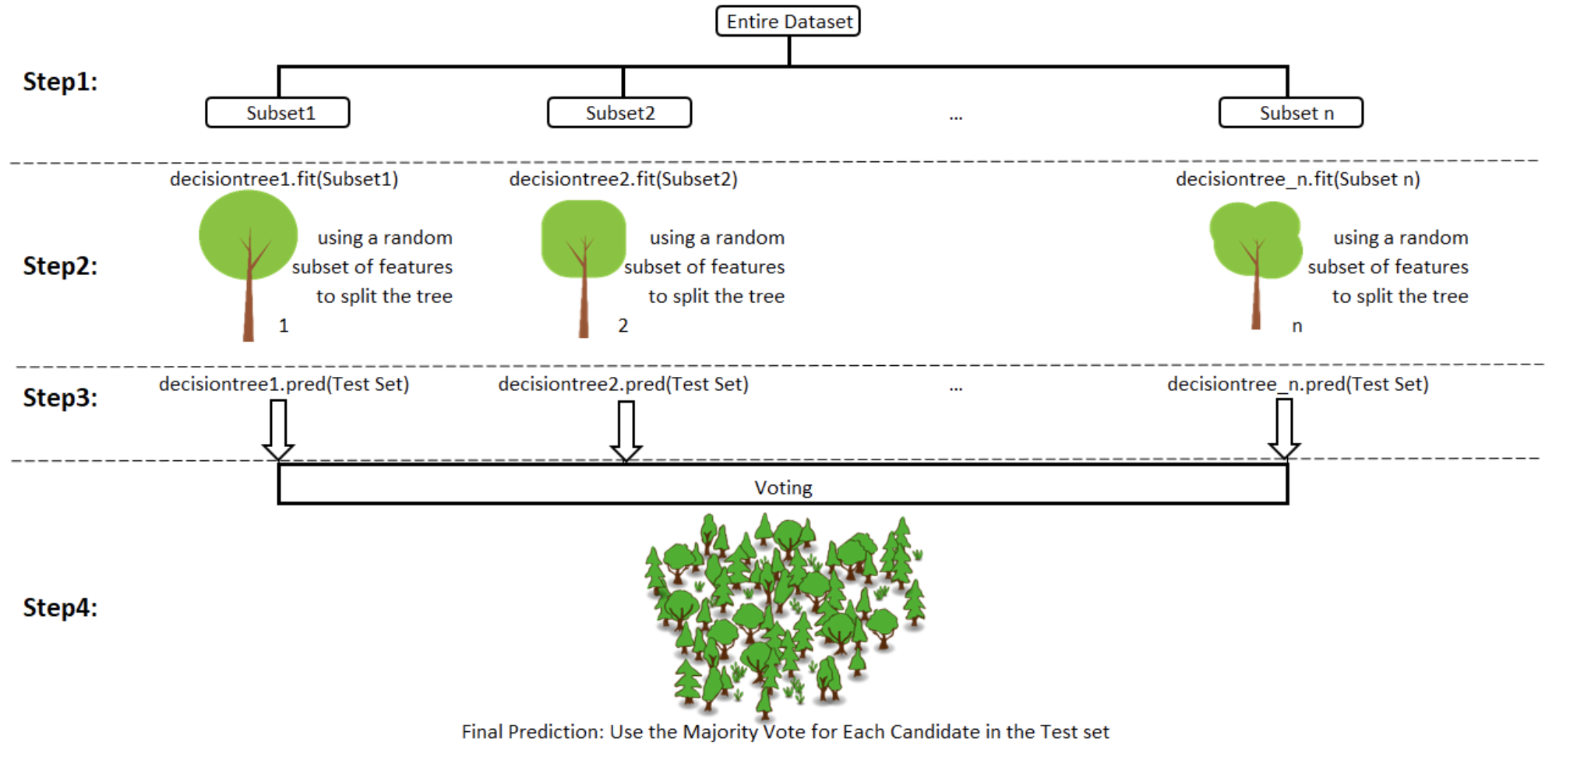
Visualizing the Forest

Slide 15
LET’S GET OUR CODE ON!

